Slide 1



Spreadsheet
Class VI
lab 25

Slide 2
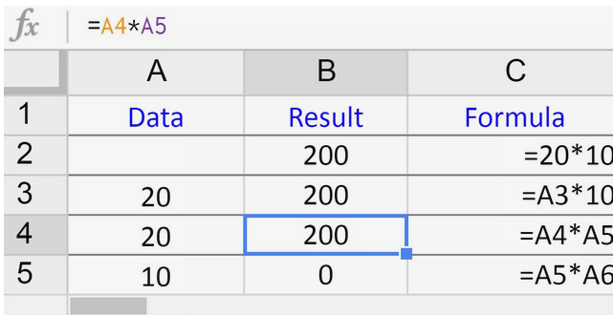
Multiplication Formula
Just use cell reference and use * sign to multiply

Slide 3
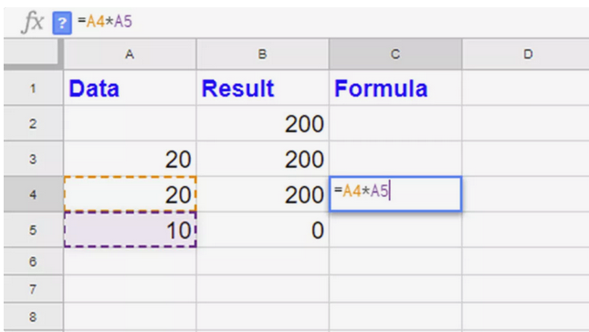
Multiplication Formula
A4 * A5

Slide 4
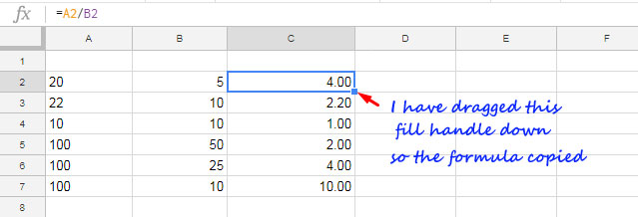
Division Formula
= DIVIDE(dividend, divisor)

Slide 5



